Slide 1
Leading AI-Enabled Product Development
Day One
Find Your Way Around the AI Initiative and Its Business Context

Slide 2
Introductions
About this Course | About Ourselves | Schedule

Slide 3










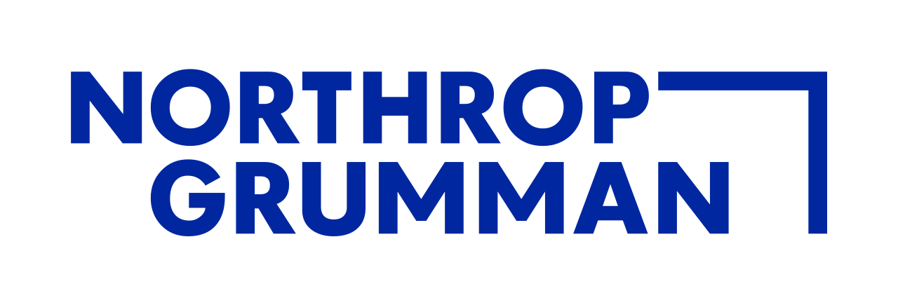
Chris Leonard
Keynotes | Training | Executive Coaching | Facilitation | Consulting
De-overwhelming teams and leaders who are stuck, burned out, and falling behind.
Notes:
1 min

Slide 4
Our Learning Objectives
Effectively predict and adapt AI initiative program and project plans
Apply key concepts of AI products: data, models, ethics, and prompt automation
Identify success factors for managing AI initiatives like quality benchmarks, rapid iteration, and cost & risk management
Manage the common risks of AI product development with proven tactics from real AI initiatives
Discover and mitigate the most common risks that stall and sidetrack major AI product development
Notes:
2 min
Give 1 minute to silently read the objectives.
Discussion: “What are your goals for this course?”

Slide 5
About this Course
Who Are We?
Names, roles, employers, locations
Our goals
Our experiences
Three Ways We Will Learn
Exposition - Slides, Video
Activities - Miro, AI Tool of your choice
Discussion - Voice, Zoom Chat, Poll
Learning Together
Instructor Expectations
PMI Expectations
Our Learning & Working Agreement
What’s Coming?
Schedule
Notes:
2 min

Slide 6
Schedule
Session 1 | Kick Off | 9:05 | 9:20
Session 1 | Exposition & Discussion | 9:20 | 9:55
Session 2 | Exposition | 10:00 | 10:10
Session 2 | Activity 1: Data Hierarchy of Needs Explained | 10:10 | 10:40
Session 2 | Activity 2: Data Hierarchy of Needs Applied | 10:40 | 11:00
Lunch |  | 11:00 | 12:00
Session 3 | Exposition | 12:00 | 12:45
Session 4 | Exposition | 12:45 | 12:50
Session 4 | Activity: Empathy Mapping Personas | 12:50 | 1:20
Session 4 | Exposition pt2 | 1:20 | 1:30
Session 4 | Activity: Write a Quality Benchmark | 1:30 | 2:00
Wrap Up | Day 1 Wrap Up | 2:00 | 2:30
Notes:
1 min

Slide 7
AI Products in Business Context
Latent Value | Deferred Modernization | Schedule

Slide 8
AI Products in Economic Context
AI opens latent economic possibilities that also require significant, often long-deferred investments.
In this section
4 case studies
Latent value
Deferred engineering work
Notes:
1 min

Slide 9
Case Studies
Pfizer
Volkswagen
Lockheed Martin
Sharp Business Systems
Constraints on success
Legacy data
Tech debt
Major engineering lift preceded or ran in parallel with AI work
AI unlocked new automation or strategic insights
Major engineering lift preceded or ran in parallel with AI work
Notes:
2 min
---
Common Themes You Can Lean On
Across these case studies, a consistent pattern emerges:
1. **Legacy data and tech debt constrained AI success:** Without strong foundations, advanced AI either fails in production or produces unreliable outputs.([CNBC][3])
2. **Major engineering lift preceded or ran in parallel with AI:** In every case, organizations had to invest in **data pipelines, unified schemas, modern infrastructure, and (often) cloud migration** before realizing substantial AI value.
3. **AI unlocked new automation or strategic insights:** Once foundations were in place, generative capabilities or predictive analytics delivered measurable business value — from regulatory compliance (life sciences) to improved production (automotive) to predictive operations (energy/defense).
---
[1]: https://www.wsj.com/tech/ai/volkswagen-to-invest-1-2-billion-in-artificial-intelligence-by-2030-e41b2021?utm_source=chatgpt.com "Volkswagen to Invest $1.2 Billion in Artificial Intelligence by 2030"
[2]: https://keyt.com/news/money-and-business/stacker-money/2025/12/15/why-95-of-enterprise-ai-projects-fail-to-deliver-roi-a-data-analysis/?utm_source=chatgpt.com "Why 95% of enterprise AI projects fail to deliver ROI: A data analysis | News Channel 3-12"
[3]: https://www.cnbc.com/2025/01/22/ai-implementation-isnt-being-done-intelligently-inside-most-companies.html?utm_source=chatgpt.com "AI implementation projects are far from intelligent inside companies”
The Data Quality Crisis Nobody Discusses
A 2024 Capital One survey conducted by Forrester Research of 500 enterprise data leaders found that 73% identified “data quality and completeness” as the primary barrier to AI success—ranking it above model accuracy, computing costs, and talent shortages.
The challenge isn’t just missing data. It’s fragmented data that AI systems can’t reconcile. The same customer might appear as “Acme Corp” in the CRM, “Acme Corporation” in email systems, “ACME Inc.” in contracts, and “Acme” in call transcripts. Without entity resolution—the ability to recognize these as the same organization—AI systems fragment their understanding across multiple incomplete profiles.
https://keyt.com/news/money-and-business/stacker-money/2025/12/15/why-95-of-enterprise-ai-projects-fail-to-deliver-roi-a-data-analysis/?utm_source=chatgpt.com

Slide 10
Case Study 1: Pharmaceutical Firm
The AI Initiative
Automate FDA document generation
Derive narratives fro, clinical summaries
Technical Context
Legacy data systems without integration
Inconsistent data schemas
Result
Early features had very long lead times
Dev was offshored to reduce cost
Quality gains were costly, and will take a long time to reduce costs
Notes:
2 min
Industry: Life Sciences
What the AI did:
Generative AI is being used to automate drafting and synthesizing sections of regulatory submissions to the FDA — for example, creating clinical summaries and regulatory narratives from complex trial outputs.
Engineering/Tech Debt Context:
Legacy clinical data was stored in disparate systems and formats. Prior to GenAI, teams lacked a unified, standardized dataset to reliably generate prose for submissions. Significant *data engineering, harmonization, and metadata tagging* were prerequisites before AI could produce quality outputs. Without those foundational investments, the generative component would have produced inconsistent or untrustworthy text.
Value Realized:
Shortened time to submission, reduced manual drafting effort, and improved regulatory compliance accuracy.

Slide 11
Case Study 2: Automotive Manufacturer
The AI Initiative
Virtual testing
Generative design
Production optimization
The Solution
Centralizing data platforms
Standardizing data schemas
Deploying new high-performance computing resources
Result
AI-assisted virtual testing that reduces physical prototype cycles by weeks or months.
Improved time-to-market
Notes:
2 min
Volkswagen — Building an AI-Powered Engineering and Manufacturing Platform (Automotive)
Initiative:
Volkswagen announced an extensive multi-billion-euro AI strategy to embed AI across engineering, manufacturing, and operations — including virtual testing, generative design, and production optimization.
https://www.wsj.com/tech/ai/volkswagen-to-invest-1-2-billion-in-artificial-intelligence-by-2030-e41b2021?utm_source=chatgpt.com
Volkswagen operates a fragmented legacy IT and data ecosystem across regions, suppliers, and factories. To deploy AI at scale (e.g., digital twins, generative simulation), VW needed to consolidate and overhaul its infrastructure, upgrade cloud services, and migrate disparate engineering systems.
This included standing up centralized data platforms, standardized data schemas, and high-performance computing resources that simply didn’t exist at scale before.
Much of the justification for the AI investment included “catch-up” modernization of core engineering and production systems so AI could operate meaningfully.
Value Realized / Expected:
AI-assisted virtual testing that reduces physical prototype cycles by weeks or months.
Better vehicle design iteration, faster time-to-market, and improved production quality monitoring.
Long-term cost avoidance and efficiency gains expected over the next decade.

Slide 12
Case Study 3: Aerospace Defense Contractor
The Initiative
Using predictive AI for complex systems engineering
Technical documentation for aerospace components
Simulation automation
Systems diagnostics.
Engineering Context
Decades-old simulation tools
Siloed engineering databases
The Solution
Normalize config. mgmt. systems
Unify product lifecycle mgmt. data
Modernize legacy situation outputs into structured data
Notes:
2 min
Aerospace Defense Contractor
Defense companies operate decades-old simulation tools and siloed engineering databases.
To enable AI recommendations or generative documentation, Lockheed’s teams had to normalize configuration management systems, unify PLM (product lifecycle management) data, and modernize legacy simulation outputs into structured datasets.
Significant data infrastructure improvement (ETL pipelines, semantic tagging, unified repositories) was required to feed advanced analytics and language models — which previously produced unreliable or inaccurate results on uncurated data.
Value Realized:
AI-augmented systems engineering sped up design reviews and compliance reporting, reduced manual simulation hours, and improved traceability for safety and certification.
Teams estimate dramatic reductions in engineering cycle times and documentation cost — contingent on that data foundation being solid.

Slide 13
Case Study 4: Business Systems Manufacturer
The Initiative
Reviving dormant accounts
Prioritizing high-fit prospects
Strengthening customer relationships
Technical Context
Fragmented data infrastructure
Business intelligence data updated infrequently
The Result
AI accelerated access to high-value human interactions rather than replacing them.
Notes:
2 min
Business Systems Manufacturer
The Initiative
Sharp Business Systems implemented AI-powered sales intelligence embedded directly into existing sales workflows. The focus was on targeted, practical use cases—reviving dormant accounts, prioritizing high-fit prospects, and strengthening customer relationships—rather than broad AI experimentation or chatbots.
Engineering / Tech Debt Context
Success depended on strengthening data infrastructure. Company integrated AI tools with reliable, real-time business intelligence (account-fit scores, intent signals, org changes), ensuring recommendations were trustworthy. This reduced friction from fragmented or outdated data that typically undermines AI adoption.
The Outcome
Sales, inside sales, and marketing teams aligned around shared intelligence, enabling better timing, prioritization, and messaging. The result was measurable account expansion across multiple product lines, with AI accelerating access to high-value human interactions rather than replacing them.
Sales is still a human process and AI helps us get to the important human interactions faster.

Slide 14
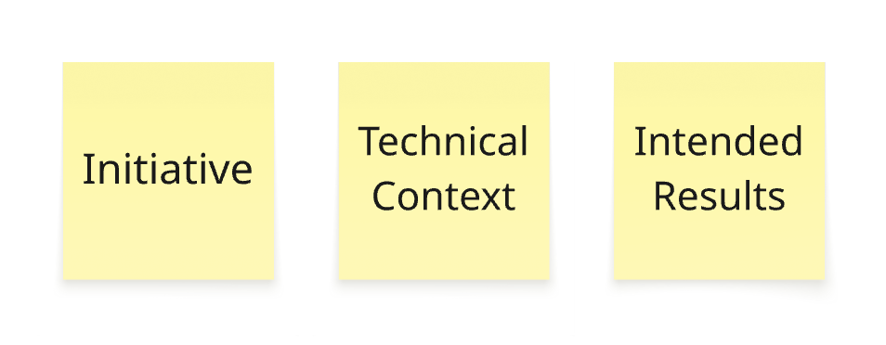
Activity 1.1
Find a use case in your company or a competitor in your industry, whether real or speculative.
  Describe the initiative in ecumenic context.
  What are latent technical investments that could complicate the initiative?
  What would success look like and how might it be measured?
Notes:
14 min
No Miro

Slide 15
Solid Data Foundations
The Data Hierarchy of Needs

Slide 16
In this section
Define the Data Hierarchy of Needs and related concepts used in AI applications
Apply the Data Hierarchy of Needs to real case studies in AI problem development for four case studies
Apply the Data Hierarchy of Needs to the planning of data engineering features
Notes:
1 min

Slide 17
Data Hierarchy of Needs
AI, Deep
Learning
AI
A/B Testing,
Experimentation,
Simple ML Algorithms
Learn
Analytics, Metrics, Segments,
Aggregates, Features, Training Data
Integration
Cleaning, Anomaly Detection, Prep
Consistency
Reliable Data Flow, Infrastructure, Pipelines, ETL,
Structured and Unstructured Data Storage
Quality
Instrumentation, Logging, Sensors
External Data, User Generated Content
Availability
Notes:
9 min
Up to now, we’ve talked about why AI initiatives trigger hidden work—especially in parts of the enterprise where data infrastructure wasn’t valuable enough to modernize before AI.
This hierarchy explains where that hidden work lives, why it shows up late, and why it often dominates schedule, scope, and cost.
As project managers, your job isn’t to become data scientists—it’s to ask the right questions early and plan for what this hierarchy makes unavoidable.
In AI programs, the model is rarely the risk. The risk is discovering—too late—that the organization hasn’t yet earned the right to use one.
—
The Hierarchy (bottom → top)
1. Data Availability / Collection
What it means
The data exists, can be accessed, and can be legally and ethically used.
Includes system access, ownership, permissions, retention policies, and compliance constraints.
Why it matters
Many enterprises discover that data technically exists but is locked in legacy systems, vendor platforms, or informal workflows.
Common latent work
Extracting data from old systems
Negotiating access with system owners
Untangling compliance, privacy, or contractual limits
PM lens
Ask early: “What data sources does this depend on, and who controls them?”
Risk signal: “We think the data is there” without named systems or owners.
2. Data Quality
What it means
The data is accurate, complete, consistent, and timely enough to be useful.
Low-quality data produces confident-looking but wrong AI outputs.
Why it matters
AI systems amplify data problems instead of smoothing them out.
Quality issues are often invisible until models start failing.
Common latent work
Fixing missing fields, duplicates, conflicting definitions
Retrofitting validation rules that were never needed before
PM lens
Ask: “How was this data used before, and what errors were acceptable then?”
Risk signal: data previously used only for reporting or audits.
3. Data Consistency & Semantics
What it means
Shared definitions across systems: same term, same meaning.
Example: “customer,” “active,” or “completed” mean the same thing everywhere.
Why it matters
AI models need conceptual consistency, not just clean rows.
This is where organizational disagreement becomes technical debt.
Common latent work
Reconciling conflicting metrics across departments
Redefining KPIs that were “close enough” for humans
PM lens
Ask: “Where do definitions differ today, and who decides the ‘real’ one?”
Risk signal: debates framed as “philosophical” instead of operational.
4. Data Integration
What it means
Data from multiple systems can be combined reliably and repeatedly.
Pipelines, joins, identifiers, and refresh cycles all work together.
Why it matters
Most AI products fail without cross-system context.
Integration work is usually underestimated because it feels “technical” and routine.
Common latent work
Building new pipelines
Creating shared IDs where none existed
Synchronizing update schedules
PM lens
Ask: “How many systems must work together for this to function in production?”
Risk signal: integration described as “straightforward” without diagrams.
5. Data Governance & Stewardship
What it means
Clear accountability for data quality, changes, and downstream impact.
Policies for access, updates, monitoring, and escalation.
Why it matters
AI systems don’t stay correct on their own.
Without governance, today’s working model becomes tomorrow’s incident.
Common latent work
Assigning data owners after the fact
Creating review and approval workflows under time pressure
PM lens
Ask: “Who is responsible when this model behaves incorrectly?”
Risk signal: governance postponed until “after launch.”
6. AI Models & Applications (the visible part)
What it means
Model training, evaluation, deployment, and UX integration.
This is the part executives usually picture when they say “AI.”
Why it matters
It’s necessary—but often not the majority of the work.
This layer depends entirely on everything beneath it.
PM lens
Reframe expectations: “This is the smallest, fastest-moving layer—if the foundation exists.”
—
Summary
This hierarchy explains why AI initiatives surface deferred infrastructure investment.
When this is outmoded, the problem isn’t neglect. Companies optimized rationally for a pre-AI world. Now AI has changed the economics, and data debt is now critical path work.
What project managers should do differently
If teams can’t confidently walk this hierarchy, the schedule is already optimistic.
The fastest way to lose trust in an AI program is to promise intelligence on top of fragile data.

Slide 18
Activity 1
Pick an unfamiliar term from the data hierarchy of needs and use an AI chatbot like Chat GPT or MS CoPilot tolerant more about it and how it might relate to your context.
We will each share about the term we learned.
Notes:
20 min

Slide 19
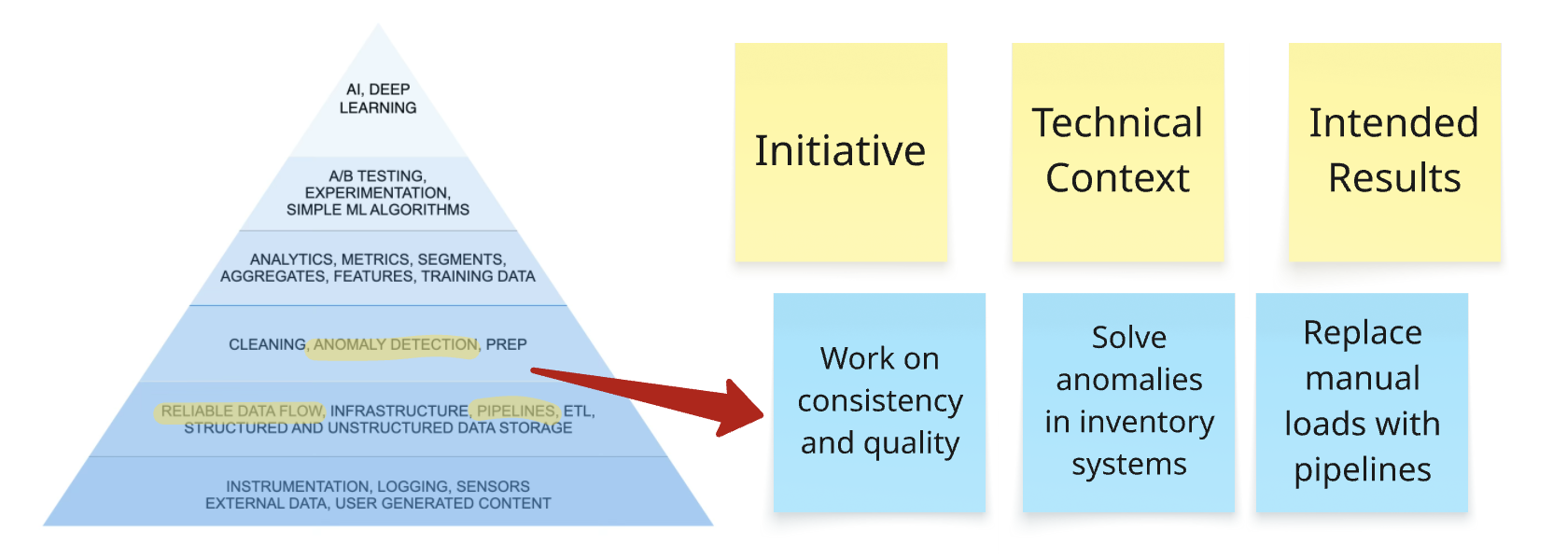
Activity 1.2
Return to your case study from the first activity and guess where in the hierarchy of needs the enterprise is and what will likely need to be done about it.
Notes:
20 min

Slide 20
Iterative Value to the MVP and Beyond
Theory of Constraints | Workflow | Prompt Automation | Agents

Slide 21
In this Section
Apply the Theory of Constraints to AI product roadmaps
Probe the crucial links between workflow automation and prompt automation
Explore how they interact in the development of agents and other AI products
Notes:
2 min

Slide 22
AI Initiatives Relieve Value Constraints
SEEK the next constraint
OBSERVE the constraint
Theory of
Constraints
ELEVATE the constraint
EXPLOIT the constraint
SUBORDINATE everything else to the constraint
Notes:
20 min
Look at it this way. If there was nothing preventing a system from achieving higher throughput (i.e., more goal units in a unit of time), its throughput would be infinite – which is impossible in a real-life system.
The data hierarchy showed us where work hides in AI initiatives. Theory of Constraints explains why that hidden work becomes the schedule.
If you’re building a roadmap for an audacious AI initiative, TOC gives you a way to sequence reality instead of optimism.
Why TOC matters for AI initiatives
AI programs are systems, not tasks.
System throughput is limited by one primary constraint at a time.
Adding resources, teams, or ambition away from the constraint does not make delivery faster—it usually makes it noisier.
PM translation
Your roadmap is only as credible as its understanding of the current constraint.
In AI work, that constraint is often not engineering capacity—it’s data readiness, governance, or organizational alignment.
1. Identify the Constraint
What it means
Find the single factor that most limits progress toward the goal.
Examples In AI initiatives
-Data access approvals
-Data quality remediation
-Integration across legacy systems
-Governance and risk review cycles
-Subject-matter expert availability
PM lens
Ask: “If we removed only one obstacle, what would most accelerate learning or value?”
Risk signal: Roadmaps that assume all dependencies are discoverable at the outset.
2. Exploit the Constraint
What it means
Get the maximum possible output from the constraint without major investment.
Examples In AI initiatives
Prioritize the highest-value use case that uses existing clean data
Time-box governance reviews with prepared decision criteria
Shield constrained SMEs from low-value meetings
PM lens
Ask: “Are we using the constrained resource on the most valuable work?”
Anti-pattern: spreading constrained experts thin “to be fair.”
3. Subordinate Everything Else
What it means
Align all other work to support the constraint—even if it feels inefficient locally.
Examples In AI initiatives
-Engineering waits on data readiness instead of racing ahead
-Feature scope is shaped by what the constraint can realistically support
-Downstream teams accept idle time to avoid rework
PM lens
This is the step most organizations resist.
Local efficiency is sacrificed for system throughput.
Risk signal
Teams optimizing their own backlogs while the initiative stalls.
4. Elevate the Constraint
What it means
Make structural investments to increase the constraint’s capacity.
Examples In AI initiatives
-Modernizing data platforms
-Funding sustained data stewardship roles
-Automating compliance and review processes
-Retiring legacy systems blocking integration
PM lens
This is where latent infrastructure work becomes explicit.
Elevation often represents the largest unplanned cost in AI programs.
5. Repeat — Don’t Let Inertia Become the Constraint
What it means
Once a constraint is broken, another one will emerge.
Continuously reassess.
Examples In AI initiatives
After data is ready, the constraint may shift to:
-Model monitoring
-Change management
-Adoption and trust
-Operational integration
PM lens
Roadmaps must be adaptive, not linear.
Success creates new constraints.
—
Most AI roadmaps fail because they assume everything improves together. TOC forces you to ask: What must be true first?

Slide 23
Relieve Constraints with Workflow Automation
User Decision Point
1. Simplify the process.
2. Automate with Logic
Logic-Automated Decision Point
3. Automate with AI
Process Automation
Simplify this!
AI Decision Point
Notes:
8 min
After identifying the current constraint using Theory of Constraints, the first question is not “Where can we use AI?” The first question is “What is the cheapest and safest way to relieve this constraint?”
Very often, the answer is workflow automation or simplifying requirements. Many enterprise constraints exist because business processes are inconsistent, overly manual, or based on historical compromises that no longer make sense.
Workflow automation removes unnecessary handoffs, enforces sequence, standardizes decisions, and eliminates work that never should have been manual in the first place. This is usually faster, cheaper, and more predictable than introducing AI.
As teams do this, two things happen. Some constraints disappear entirely because the process was the real problem. Others become very clear and very narrow.
That is where AI fits. AI becomes valuable when the remaining constraint requires judgment, interpretation, or pattern recognition that cannot be reliably captured in rules. At that point, an AI decision point is often the most cost-effective way to move the system forward.
So the progression is deliberate. First simplify the process. Then automate what can be deterministic. Only then introduce AI where variability and judgment are unavoidable.

Slide 24

Planning a Basic Prompt Automation Feature
Offline
AI
Prompt Templates
Data
Offline
Prompt Assembly
Finished Prompt
AI Processing
Output
User Action
Stored Personas
`
Return to user
File Attachments
Notes:
8 min
Most people think of AI as a chat window where a human types a prompt and reads a response. That mental model breaks down quickly in real AI products. In many enterprise systems, no human ever writes or sees the prompt.
Prompt automation means the application assembles instructions and context automatically. A user action—such as uploading a file or submitting a form—triggers normal application logic.
The system then builds a prompt from multiple sources. This typically includes a predefined prompt template, relevant data pulled from databases, and supporting documents or files.
That assembled prompt is sent through an API to a large language model like GPT, often with additional attachments. The model returns an output.
That output may be shown to a user, or it may be consumed by the application itself to make a decision, route work, update records, or trigger the next step in a workflow.
This is why AI features often look simple but hide significant complexity. The real work is in supplying clean, well-governed context and managing how prompts are constructed and used.
Prompt automation depends entirely on the data foundations discussed earlier. If you cannot explain where a prompt’s inputs come from, you cannot confidently plan the schedule, scope, or cost of an AI initiative.

Slide 25
Relieving Constraints with Agents
AI
Business Logic
AI Model
AI Processing
Most Likely Decision
Action
Observation
Learning
Agent Trigger
Automation
Adapt
Notes:
4 min
So far, we’ve talked about workflows, automation, and prompts as things that respond to a single request. An agent changes the model. Instead of responding once, an agent is designed to pursue an outcome over time.
An AI agent combines three things: business logic, automation, and an AI model. The business logic defines what success looks like and what is allowed. The automation gives the agent tools—systems it can query, actions it can take, and steps it can repeat.
In this model, the AI is not given a long, handcrafted prompt each time. It is given criteria, relevant information, and boundaries. The agent decides what to do next within those constraints.
This is a shift from prompt and generative output to criteria, information, and decision. The output is not necessarily text. The output may be an action, a choice, or a sequence of steps.
Because the agent can reason across steps, it often needs fewer inputs. It can gather additional information itself, retry when something fails, and adapt its approach based on results.
This is why agents can unlock more value with less orchestration. They reduce the need to predict every scenario upfront and instead rely on decision-making within guardrails.
For project managers, this increases leverage but also responsibility. The critical work shifts to defining goals, constraints, escalation rules, and stopping conditions. When those are clear, agents can safely and reliably extend automation beyond what rules or single prompts can achieve.

Slide 26
Summary
SEEK
OBSERVE
Simplify Processes
Process Automation
Prompt Automation with Gen AI
Agentic AI
ELEVATE
EXPLOIT
SUBORDINATE
Notes:
1 min - summary
4 min - discussion
In this module, we used the Theory of Constraints as a practical way to think about AI product development. Instead of starting with tools or ambition, we started with the system and asked what is actually limiting progress.
We saw that the cheapest and safest way to relieve a constraint is usually simplification or workflow automation. Many problems disappear once irrational processes are removed and deterministic work is automated.
When constraints require judgment, interpretation, or pattern recognition, prompt automation becomes useful. Here, AI operates behind the scenes, assembling context and producing outputs that users may never see.
When even more leverage is needed, agents combine business logic, automation, and AI to pursue outcomes over time. The paradigm shifts from prompts and outputs to criteria, information, and decisions.
The core lesson is this: effective AI roadmaps are not feature plans. Predictive planning really falls apart because new constraints often reveal themselves as others are removed. For each one, it’s about using the simplest mechanism that can reliably move the system forward.
---
Where in your current organization do constraints persist because no one has questioned the process itself?
Which parts of your roadmap could likely be solved with simplification or automation, but are being labeled as “AI problems”?
If an AI initiative in your organization failed, where would you expect the real constraint to have been?
What would change in your planning approach if you treated AI as a system capability rather than a set of features?
Where would introducing an agent create clarity—and where would it introduce unacceptable risk?

Slide 27
Rapid Quality and Accuracy in Outputs
Personas | Benchmarking | Style Guides | Breakdown

Slide 28
In This Section
Apply the concept of personas to user story development and prompt engineering
Study quality benchmarks and how to use them in prompt-automated QA of GenAI outputs
Apply style guides to the formatting and construction of prompts
Decomposing GenAI features
Notes:
1 min

Slide 29
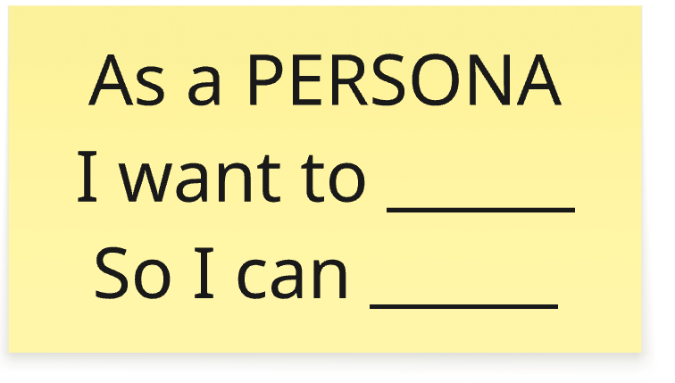
Personas and Generative AI
Attitude
Skillset
Role
Education
Background
Preferences
Notes:
4 min
Personas are a major component of many automated prompt-builders that can guide an AIs to the intended business results. The purpose is for the AI to inhabit the attitude and mindset of the ideal human author as authentically as possible if not better.
This can mean getting in the head of the intended user. Fortunately, UX designers and product managers have been doing this for decades. The empathy map is a great tool for bringing a cross-functional team together to define a persona - name it, give it color, and define what matters about it.
Defining personas early in an AI initiative, and refining them throughout, can be a powerful force multiplier to speed the rate at which the solution iterates toward the optimal business outcome.
With the right people in the room, a 30 minute session can knock this out and get you moving.

Slide 30
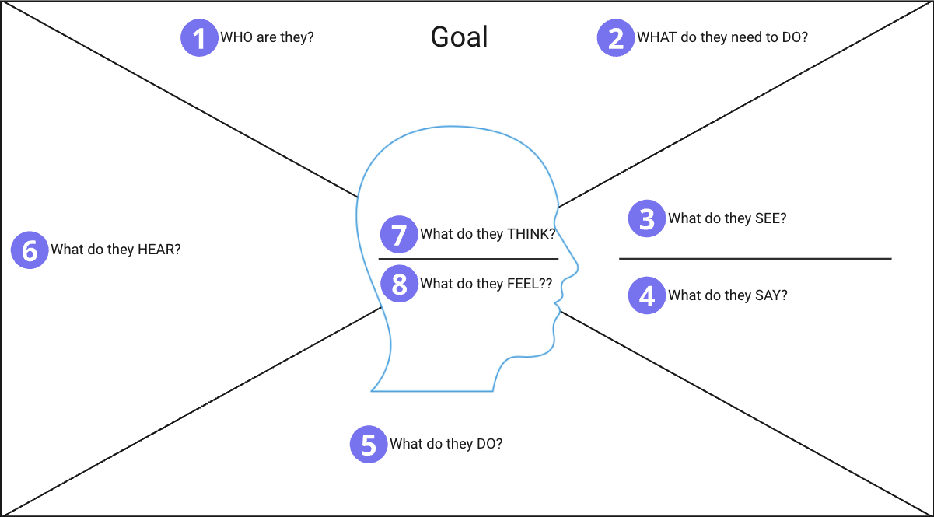
Activity 1.3: Ideating Personas With Empathy Maps
Empathy Map Canvas
Notes:
Walk through the empathy map canvas on the Miro using one of the case studies from earlier.
30 min - total
15 min - work
10 min - sharing
5 min - debrief

Slide 31




Style Guides
AaBbCc
Notes:
3 min
Consistency is one of the hardest problems in AI-generated content and AI-driven quality checks. The solution is rarely more prompting. It is usually clearer standards.
Organizations already have style guides, brand guidelines, legal language rules, and regulated terminology. On screen you see some examples of publications with famous and influential style guides. Most organizations have similar assets that can be embedded directly into how AI systems are trained, configured, and evaluated.
When a style guide is treated as infrastructure, the AI is no longer guessing. It knows which words to use, which terms must be capitalized, how citations should appear, and which phrases are required or forbidden in regulated contexts.
This applies both to generation and to automated quality checks. The same rules that shape outputs can be used by AI to review content for compliance, consistency, and risk.
For project managers, this reframes style guides from optional documentation into operational assets. If standards are ambiguous, AI outputs will be inconsistent. If standards are explicit, AI can enforce them at scale.

Slide 32
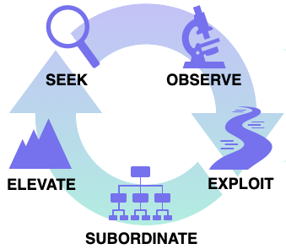
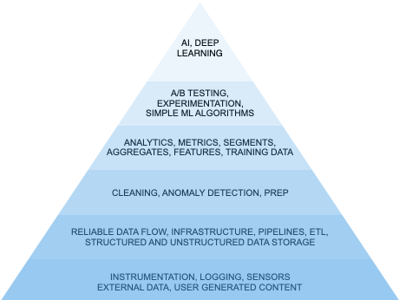
Decomposing AI Features
What constraint does the feature relieve?
Data Readiness
Process Automation
Prompt Automation
Pipe-lines
Mapping & Schema
API Creation
Field En-forcement
Quality Bench-marks
Simple Prompting
Pipe-lines
Verifi-cation
Back end Integration
Decision Auto-mation
Style Guide
Template
Notes:
5 min
One of the fastest ways AI initiatives get into trouble is by treating an AI feature as a single unit of work. From a planning and delivery perspective, that is almost always wrong.
Using the Theory of Constraints, the first question is not what the feature does, but what constraint it is meant to relieve. Every Gen AI feature exists to remove friction, reduce delay, or improve decision quality at a specific point in a workflow.
Once that constraint is clear, the feature can be decomposed into layers. The bottom layer is always data. What information must be available, clean, integrated, and governed for this feature to work reliably? If that data is missing or inconsistent, the feature is already at risk.
Next is the workflow layer. Where does this feature sit in an existing process? What happens before it, and what happens after it? Many Gen AI features only work if upstream steps are standardized and downstream actions are automated.
Above that is the automation logic. This includes the rules, branching, thresholds, and guardrails that determine when the AI is used, what inputs it receives, and how its output is handled. This is where simplification and non-AI automation often remove more risk than the model itself.
Then comes prompt automation. What instructions, templates, examples, and contextual data are assembled for the model? This is not a single prompt, but a managed asset that evolves over time.
Finally, decide whether the feature needs a single AI call or an agent. If the task is bounded and deterministic after interpretation, a single AI interaction is usually sufficient. If the feature requires iteration, information gathering, or decision-making over time, an agent may be justified.
When decomposed this way, a Gen AI feature stops being mysterious. It becomes a system with identifiable risks, dependencies, and constraints.
For project managers, this decomposition makes AI work planable. It reveals where the real effort lies, which risks are structural, and which constraints must be addressed first to make the roadmap credible.

Slide 33

Quality Benchmarking
AI System Quality in Use
Effectiveness
Efficiency
Satisfaction
Freedom from Risk
Context Coverage
ISO/IEC 25059:2023
Notes:
2 min
https://code4thought.eu/2025/02/19/generative-ai-quality-testing-a-standards-based-approach-for-reliability/
https://www.iso.org/standard/80655.html
Non-Deterministic Output
By design GenAI models are expected to be able to produce diverse responses to the exact same input at any specific point in time. This variability complicates testing, as it requires assessing multiple plausible outputs rather than a single expected result.
Quality and Consistency
Ensuring that GenAI-generated content is accurate, contextually relevant, and free from factual errors is critical. The challenge lies in defining and measuring what constitutes “acceptable” quality, especially when subjective elements such as creativity and tone are involved.
Bias and Fairness
GenAI models inherit biases present in their training data, potentially leading to biased, unfair, or inappropriate outputs. Testing must include robust fairness assessments and mitigation strategies to prevent the reinforcement of harmful biases.
Data Privacy and Security
Security is a major concern, as GenAI models can inadvertently expose sensitive or proprietary information. Testing protocols must ensure that models do not memorize and bring up confidential data and are resistant to data poisoning attacks.
Evolving Evaluation Metrics
Traditional AI evaluation metrics, such as accuracy and F1 scores, may not suffice for GenAI. Organizations are developing new benchmarks to assess attributes like reasoning, adaptability, and creativity. For example, real-world problem-solving tests are increasingly used to evaluate AI performance in practical applications.
Model Drift
Over time, GenAI models may experience “drift,” similarly to any ML model, where their outputs deviate from expected behavior due to new training data or changing usage patterns. However, identifying the drift and its root causes accurately is much more difficult compared to the ML paradigms. Continuous monitoring and fine-tuning are essential to maintain reliability and performance.

Slide 34
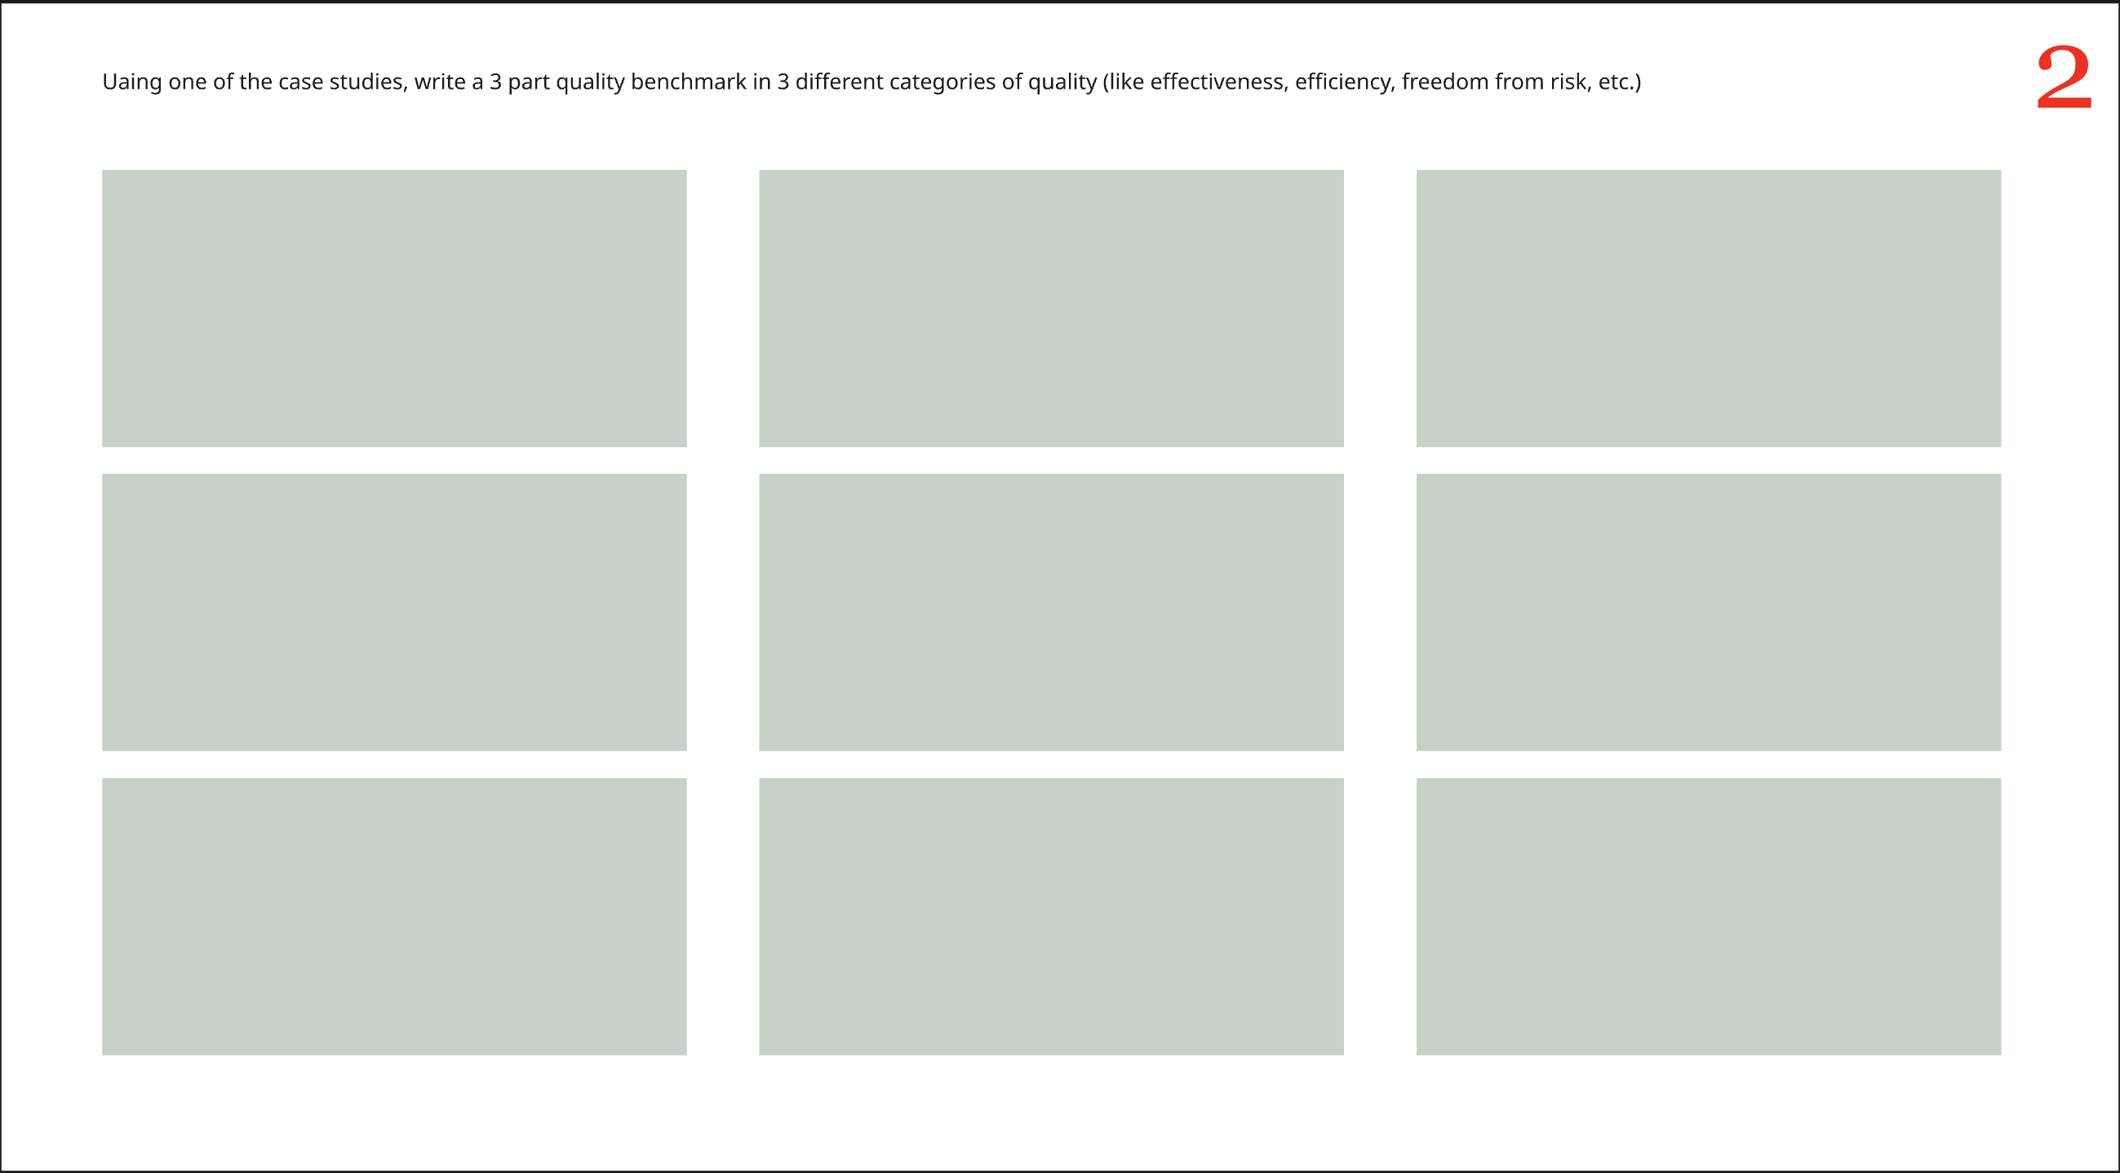
Activity 1.4: Write a Quality Benchmark
Notes:
25 min total
3 min explanation
12 min activity
10 min discussion
Using one of the case studies, write a 3 part quality benchmark in 3 different categories of quality (like effectiveness, efficiency, freedom from risk, etc.)

Slide 35
Day One Wrap Up
At this point you can:
Identify risks & false assumptions in an AI initiative’s business case
Raise and manage data dependencies using the hierarchy of needs as a map to data readiness
Translate data readiness gaps into feature definitions for tory mapping
Align an AI initiative’s roadmap around relieving s series of key constraints

Slide 36
End of Day One

